Slide 1



Clean Fuel, Cleaner Skies
Ethanol to Jet Fuel
Tackling global warming sustainably and economically.
Joshua Olusoji Omar Zaruk
Sanad Abu Hweij Srija Bomma
[1]

Slide 2
AGENDA
01
02
Introduction
Process Description
03
04
Appendix
Q&A
How SAF economically addresses rising CO₂ levels.
The ethanol-to-jet process & competing processes.
All the necessary info on production and location.
Time to answer your burning questions!
[2]

Slide 3
01
Introduction
What makes SAF production sustainable & economical?
[3]

Slide 4
29%
The Global Warming Problem
Approx. 165 trillion metric tons of CO₂!
Of all green house gas emissions are due to transportation
9%
Of which is via aircraft!
[1] United States Environmental Protection Agency. Sources of Greenhouse Gas Emissions. United States Environmental Protection Agency. https://www.epa.gov/ghgemissions/sources-greenhouse-gas-emissions.
‌
[4]

Slide 5
2050
Grand Challenge: Completely replace all Jet A fuel with SAF domestically
Aviation is exceptionally hard to decarbonize! It’s mobile, requires high energy density fuel, and currently hard to innovate!
[2] Sustainable Aviation Fuel Grand Challenge: Tracking Metrics and Mid-2024 Dashboard. Energy.gov. https://www.energy.gov/eere/bioenergy/articles/sustainable-aviation-fuel-grand-challenge-tracking-metrics-and-mid-2024.
[5]

Slide 6
Current Market Size & Future Trajectory
The global SAF market is forecasted to reach $25.62B by 2030, reflecting rapid industry expansion
The SAF market is rising because airlines, governments, and industries are pushing for cleaner fuels to meet sustainability and emission-reduction goals
.
[6]
Column 1: Renewable transport – Renewables 2025 – Analysis - IEA. Renewable transport – Renewables 2025 – Analysis - IEA. IEA. https://www.iea.org/reports/renewables-2025/renewable-transport

Slide 7
Global Market for Jet Fuel A & SAF
Jet A remains the main fuel in 2025, but SAF usage is expected to surge in the coming decades
By 2050, SAF is projected to replace Jet A fuel domestically to meet global sustainability goals
Column 2: Braun, M.; Grimme, W.; Oesingmann, K. Pathway to Net Zero: Reviewing Sustainable Aviation Fuels, Environmental Impacts and Pricing. Journal of Air Transport Management 2024, 117, 102580–102580. https://doi.org/10.1016/j.jairtraman.2024.102580.
‌
[7]

Slide 8
Environmental Analysis
Different feedstocks produce significantly different GHG reductions
Forest residue delivers the highest reduction at 98%, making it the cleanest option
Even lower-performing options like BOF gas still achieve significant reductions compared to fossil fuels
Column 3: Abhijit. Handler2015LanzaTechLCA (1). Scribd. https://www.scribd.com/document/693510729/Handler2015LanzaTechLCA-1 (accessed 2025-12-10).
‌
.
[8]

Slide 9
Raw Material Pricing and SAF Sell Price
Ethanol cost | SAF Cost & Sell Price
Regular ethanol costs $1.70–$2.00/gal | SAF feedstock cost ends up around $3.40–$4.25/gal
Low-carbon ethanol (LanzaTech) is about $2.50/gal | Jet A sells for $2.30–$2.70/gal
low carbon ethanol from brazil is $2.20/gal | SAF sells for $5–$7/gal today
 | Incentives can bring effective SAF cost down to $2–$4/gal
[9]

Slide 10
Incentives & Credits
Why earning credit matters?
Credits are important because SAF is expensive to produce. By using low carbon ethanol, we qualify for the highest value incentives.
What are RINs ?
RINS are EPA credits we earn for making clean, renewable fuel.
Because our ethanol is very low carbon, we qualify for the highest value RINS (D3). Which are worth $2.40 per gallon
45z Tax Credit
Add up to $1.75 per gallon. The lower the carbon Intensity, the higher the payout, and we qualify for the highest payout
Column 4: US EPA,OAR. RIN Trades and Price Information | US EPA. US EPA. https://www.epa.gov/fuels-registration-reporting-and-compliance-help/rin-trades-and-price-information.
‌
[10]

Slide 11
02
Competing Processes
How else is SAF derived?
[11]

Slide 12
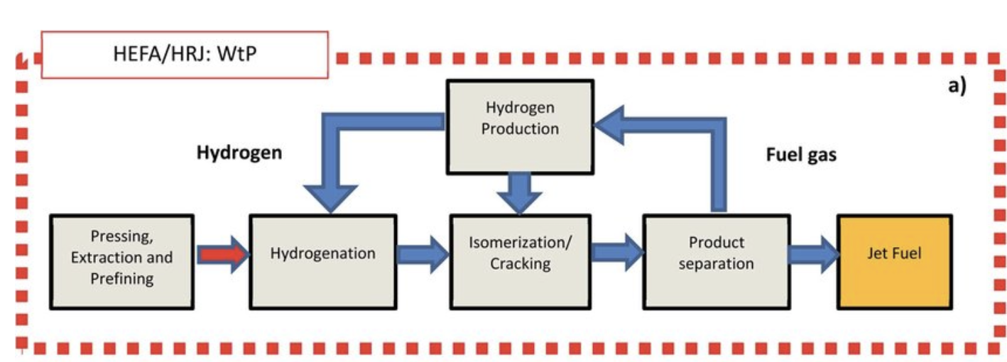
HEFA Process
Feedstock: Oil-based products (FOGS)
Major Licensors: UOP, Neste, Axens, & Haldor-Topsoe,
Advantages: Utilizes oil & grease, simpler* process pathway, most industrialized
Disadvantages: Feedstock is food, limited quantity, and expensive
Figure 1. Overview of the HEFA (hydro processed esters and fatty acids) pathway
Source: Adapted from the HEFA schematic in “Overview of HEFA, Fischer–Tropsch, and sugar‑to‑jet pathways,” as reproduced on ResearchGate (Figure 2).​
[12]
Notes:
HEFA is simpler because the process is similar to petroleum hydrotreating

Slide 13
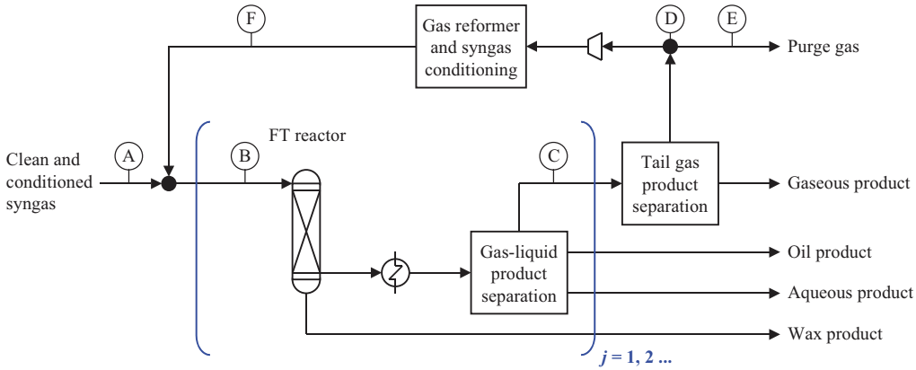
Gasification/Fisher Tropsch
Figure 2. Simplified Fischer–Tropsch gas loop for low-temperature FT (LTFT) showing clean syngas feed (point A), FT reactor
Source: Adapted from de Klerk, A., "Fischer–Tropsch process," in Kirk-Othmer Encyclopedia of Chemical Technology, John Wiley & Sons, [2013].
Feedstock: Biomass,
Advantages: High diversity of feedstock, wide range of products,
Major Licensors: Fulcrum Bioenergy, VLS, & Rentech.
Disadvantages: Complicated process, high CAPEX and OPEX, co-products produced
[13]

Slide 14
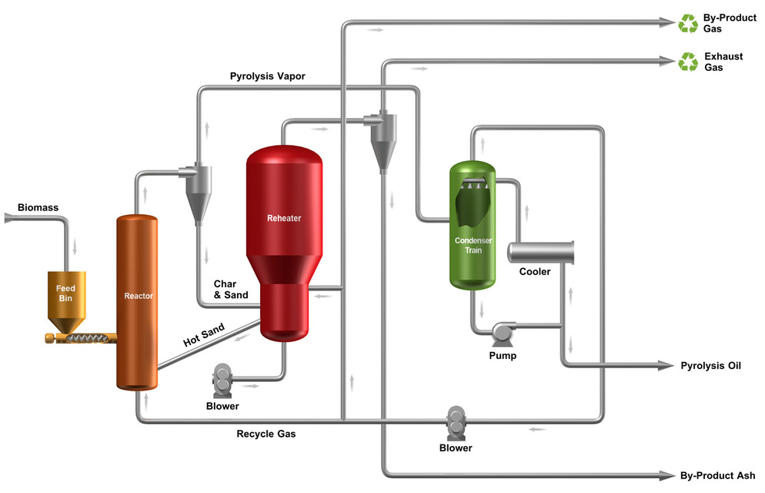
Pyrolysis/Hydrotreating
Feedstock: Waste feedstock biomass
Major licensors: Envergent, Honeywell
Advantages: Handles diverse feedstocks & low cost of production
Disadvantages: Unstable pyrolysis oil, reactor plugging and high catalyst cost
Figure 3: Fast Pyrolysis Process
Source: Ensyn Corporation, "Technology Overview: RTP® Process," 2015.
[14]

Slide 15
Flexible Feedstock
High SAF Selectivity
WHY ETHANOL TO JET?
Clean Process
Proven Procedure
Green ethanol can be derived from corn, sugarcane, waste & more!
Up to 90% of hydrocarbons produced are in jet fuel range!
No char, tar, or other hard to handle co-products.
Recently commercialized and ASTM certified by LanzaJet!
[15]

Slide 16
03
Chosen Process
The ETJ-SAF Pathway.
[16]

Slide 17
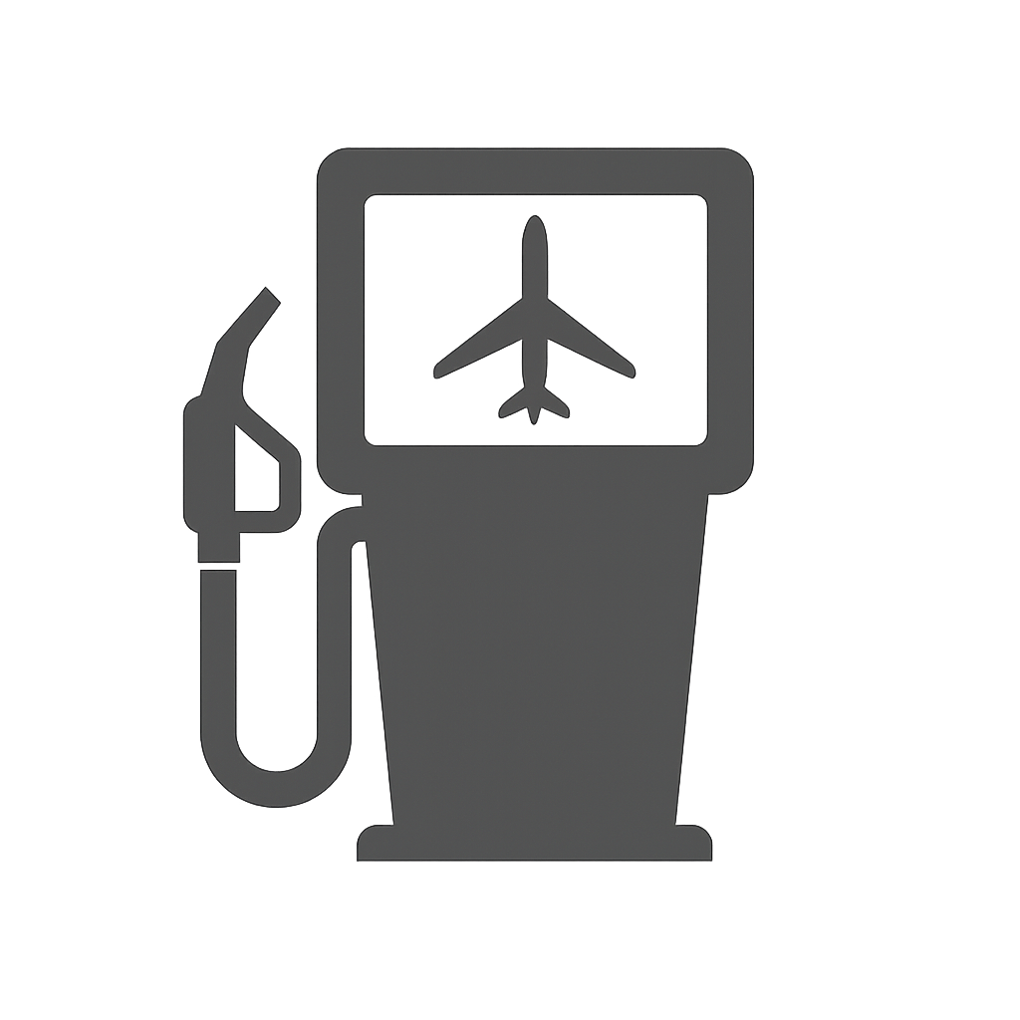
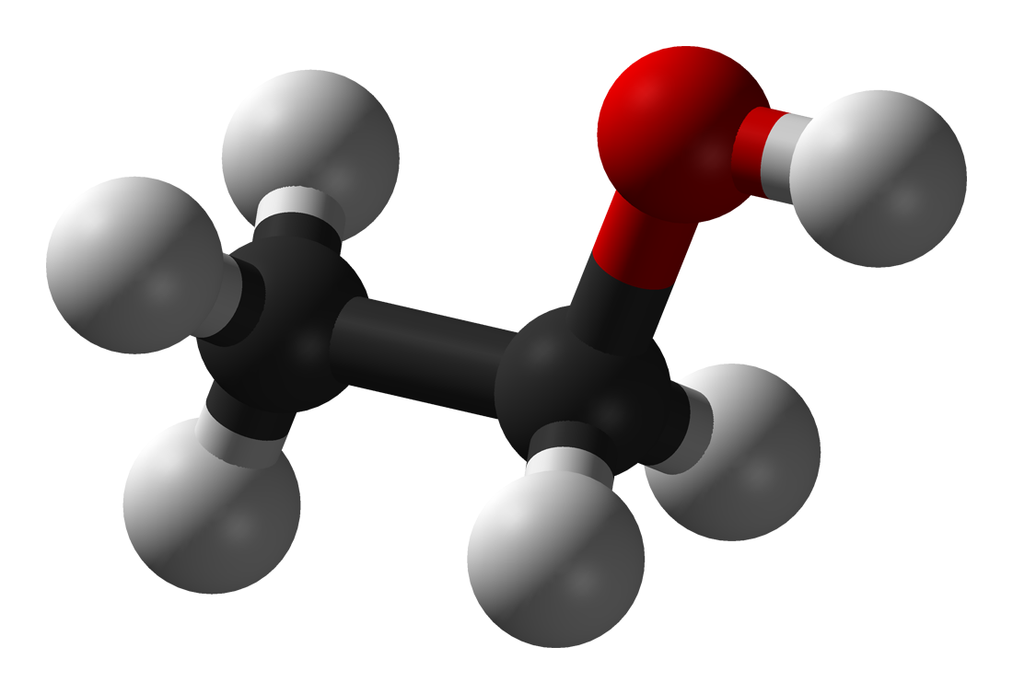

Chosen Process
Ethanol
Jet fuel
Dehydration
Oligomerization
Hydrogenation
Hydroprocessing
CH₃–CH₂–OH ⟶ CH₂=CH₂ + H₂O
n C₂H₄ ⟶ C₂ₙH₄ₙ
R–CH=CH–R' + H₂ ⟶ R–CH₂–CH₂–R'
R–CH₂–CH₂–R' + H₂ ⟶ R–CH₃ + CH₃–R’ (n-parrafins)
n-parrafins ⟶ iso-parrafins
[17]

Slide 18
Dehydration
[18]

Slide 19
Oligomerization
[19]

Slide 20
Hydroprocessing
[20]

Slide 21
04
Appendix
Design Basis, Material Balances & BFD
[21]

Slide 22
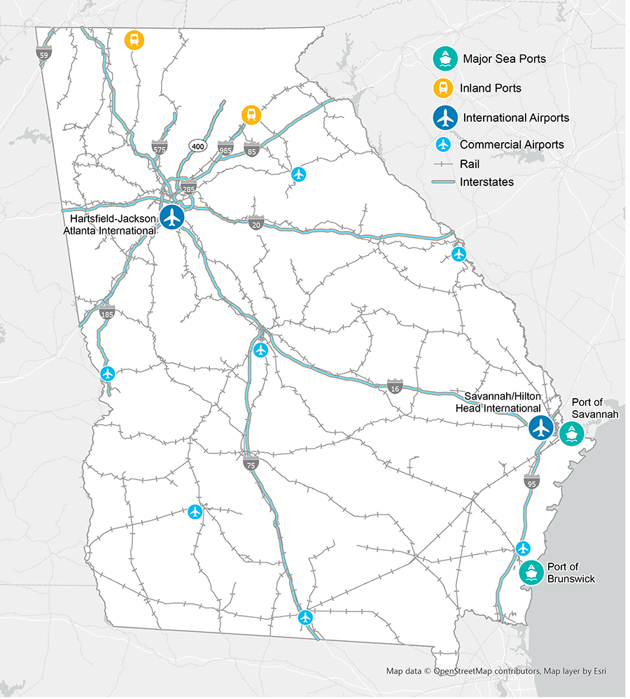
PLANT DESIGN BASIS
Location: Wilkinson County, Georgia
In-state feedstock & access to Port Savannah for international transactions!
Close proximity to Hartsfield-Jackson & Savannah Hilton airports!
Wilkinson County, Georgia
Production: 10,000 Barrels/Day
10,000 barrels is equivalent to 420,000 gallons. This high, daily production would maximize profitability.
[22]

Slide 23
Block Flow Diagram & Material Balances
Dehydration
Oligomerization
Hydroprocessing
[23]

Slide 24



SPECIAL THANKS
LANCE BAIRD
KIRAN GUPTE
BETUL BILGIN
[24]

Slide 25
References
United States Environmental Protection Agency. Sources of Greenhouse Gas Emissions. United States Environmental Protection Agency. https://www.epa.gov/ghgemissions/sources-greenhouse-gas-emissions.
Sustainable Aviation Fuel Grand Challenge: Tracking Metrics and Mid-2024 Dashboard. Energy.gov. https://www.energy.gov/eere/bioenergy/articles/sustainable-aviation-fuel-grand-challenge-tracking-metrics-and-mid-2024.
Frey, S. J. (2024). Process and apparatus for converting aqueous alcohol to ethylene (U.S. Patent Application No. US 2024/0217895 A1). U.S. Patent and Trademark Office.
Gosangari, S. L., Serban, M., Abrams, M. L., & Schilling, K. (2024). Radial flow reactor for an ethanol dehydration process (U.S. Patent Application No. US 2024/0190794 A1). U.S. Patent and Trademark Office.
Gosangari, S. L., Serban, M., Mathur, A., & Tope, B. (2024). High temperature final dehydration reactor in dehydration process to prevent diethyl ether production (U.S. Patent Application No. US 2024/0279138 A1). U.S. Patent and Trademark Office.
Jadaun, K. P., Dalal, V. V., Frey, S. J., Bose, A., & Sharma, R. (2024). Process for converting olefins to jet fuel (U.S. Patent Application No. US 2024/0218268 A1). U.S. Patent and Trademark Office.
de Klerk, A. (2013). Fischer–Tropsch process. In Kirk‑Othmer encyclopedia of chemical technology. Hoboken, NJ: John Wiley & Sons.
[25]

Slide 26
References
Ensyn Corporation. (2015). Technology overview: RTP® process. Retrieved from https://www.ensyn.com/technology.html​
Wang, W. C., & Tao, L. (2016). Bio‑jet fuel conversion technologies. Renewable and Sustainable Energy Reviews, 53, 801–822.
U.S. Fuel Ethanol Plant Production Capacity. www.eia.gov.https://www.eia.gov/petroleum/ethanolcapacity/.
US EPA,OAR. RIN Trades and Price Information | US EPA. US EPA. https://www.epa.gov/fuels-registration-reporting-and-compliance-help/rin-trades-and-price-information
Braun, M.; Grimme, W.; Oesingmann, K. Pathway to Net Zero: Reviewing Sustainable Aviation Fuels, Environmental Impacts and Pricing. Journal of Air Transport Management 2024, 117, 102580–102580. https://doi.org/10.1016/j.jairtraman.2024.102580.
Renewable transport – Renewables 2025 – Analysis - IEA. Renewable transport – Renewables 2025 – Analysis - IEA. IEA. https://www.iea.org/reports/renewables-2025/renewable-transport.
‌
[26]

Slide 27
ANY QUESTIONS?
[27]

Slide 28
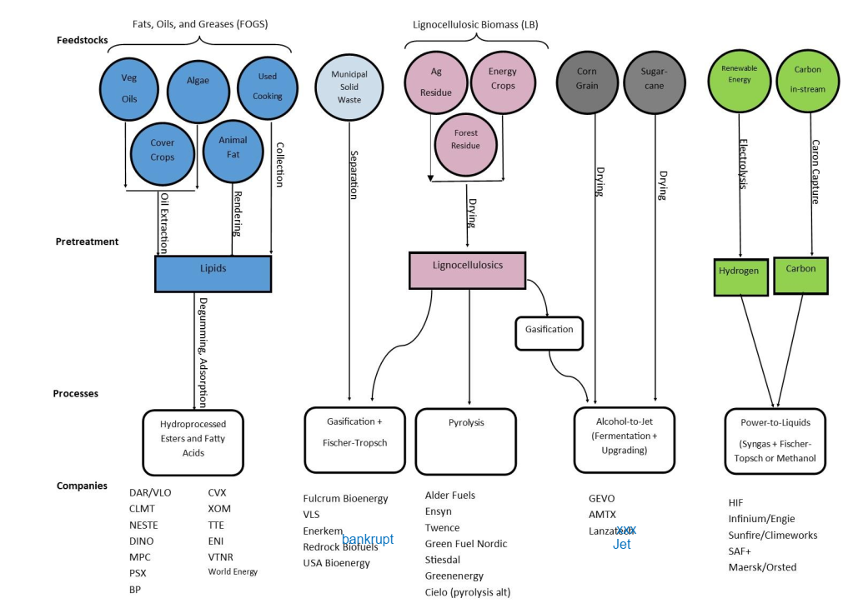
Cowen 2022

Slide 29
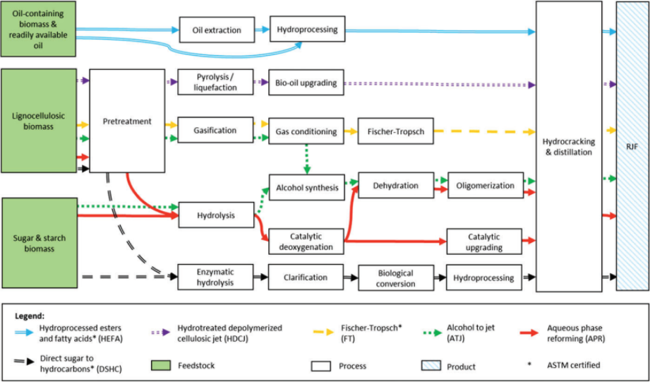

Slide 30
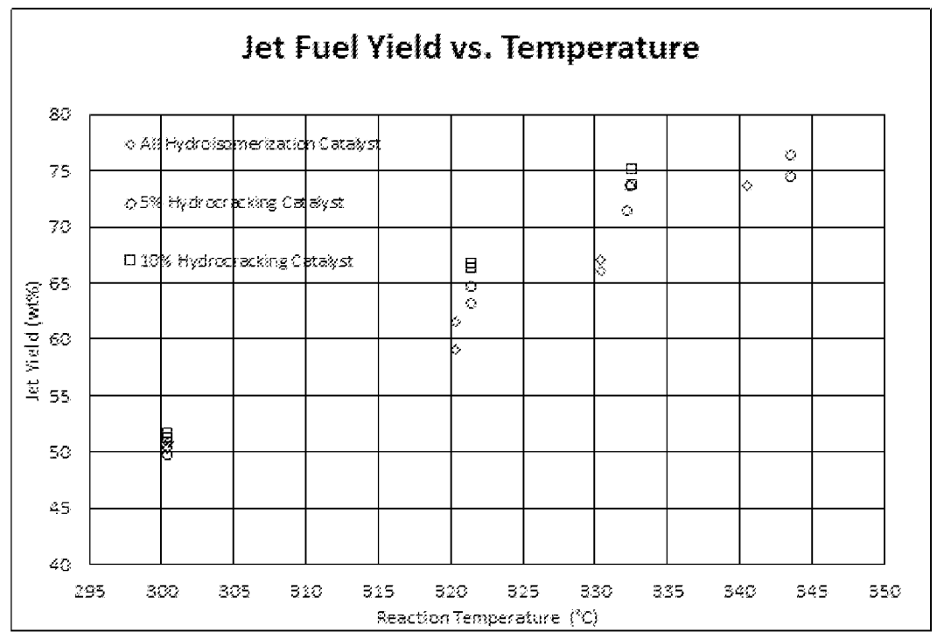

Slide 31
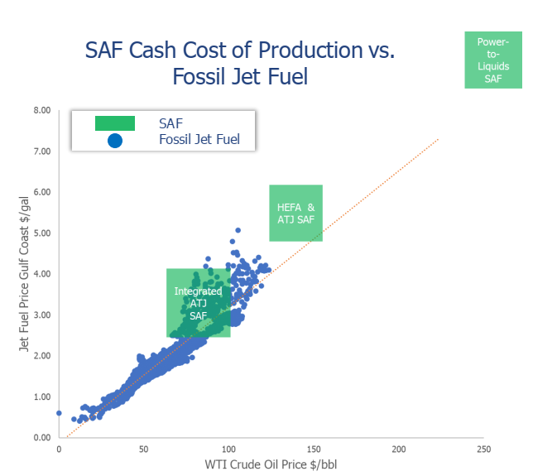

Slide 32
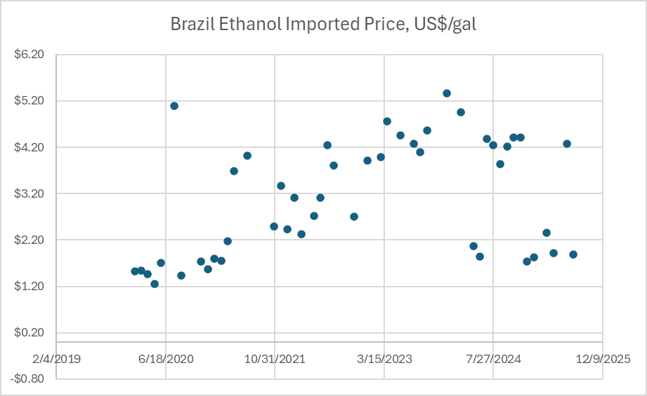

Slide 33
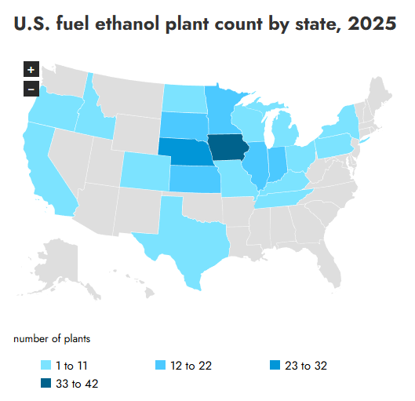

Slide 34
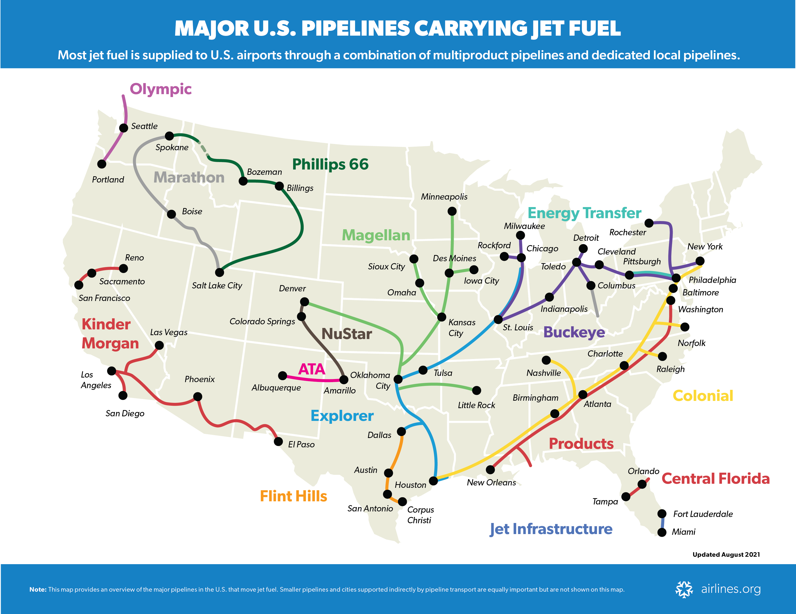

Slide 35
What Are RINs?
RINs are Renewable Identification Numbers
They are EPA-issued credits for producing clean, renewable fuel
Each gallon of renewable fuel generates a unique RIN credit
These RIN credits can be sold for money, creating extra revenue
Low-carbon fuels earn the most valuable RINs — called D3 RINs

